Slide 1
JHAN TRAVELS
ONLINE BUS SEAT RESERVATION SYSTEM
V.Nikhitha - 18wh1a0579 K.Jashwanthi - 18wh1a0588 R.Sai Harshitha-18wh1a0599
V.Amulya Chandhana - 18wh1a05A3
August 28, 2020

Slide 2
TABLE OF CONTENTS
ABOUT THE PROJECT SOFTWARES USED
FRAMEWORKS AND DATABASE SERVERS USED
SYSTEM REQUIREMENTS
LANGUAGES USED PROJECT FLOW CHALLENGES FACED
1
2
3
4
5
6
7

Slide 3
ABOUT THE PROJECT
JHAN TRAVELS is an online bus seat reservation website.This website enables the users to look for the buses by entering the source, destination and date of journey.Users can then choose a bus of their choice .In order to book the seats the user must complete the registration process .Then they can select the seats in their selected bus.Once booking is done a conformation mail is sent to the user.The user can view their tickets and can cancel them if required.Also provided a unique feature “Baggage” which allows the user to export only the baggage to the respective destination.

Slide 4
SOFTWARES USED
Visual Studio
Node JS
Eclipse Java EE

Slide 5
FRAMEWORKS AND DATABASE SERVERS USED
FRAMEWORKS :
Angular
jQuery
DATABASE SERVERS :
MYSQL
Apcahe Tomcat Server Hibernate

Slide 6
SYSTEM REQUIREMENTS
OS - Windows 10 or Windows 7/Linux Processor - Intel i5
Java version - JDK-8
Disk Storage - minimum 4GB free disk space Internet

Slide 7
LANGUAGES USED
TypeScript
JavaScript and jQuery HTML and CSS
Java

Slide 8
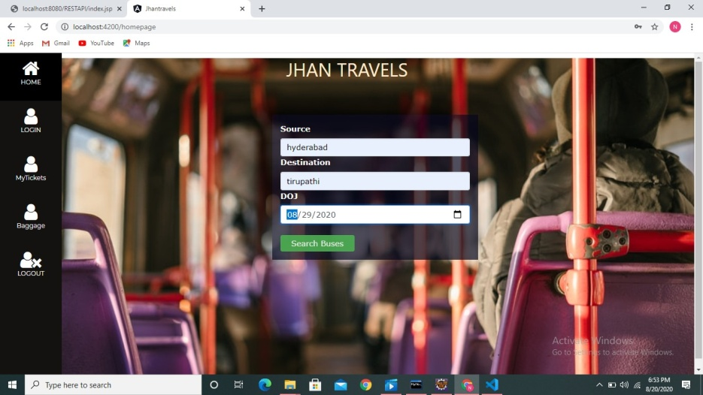
PROJECT FLOW
HOME PAGE

Slide 9
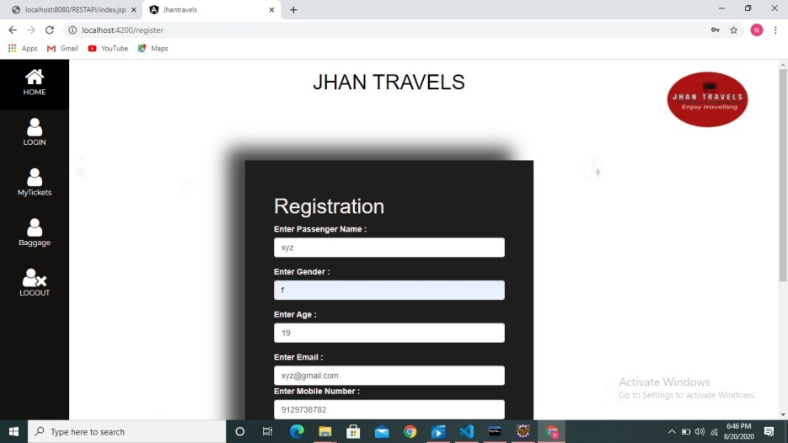
REGISTRATION PAGE

Slide 10
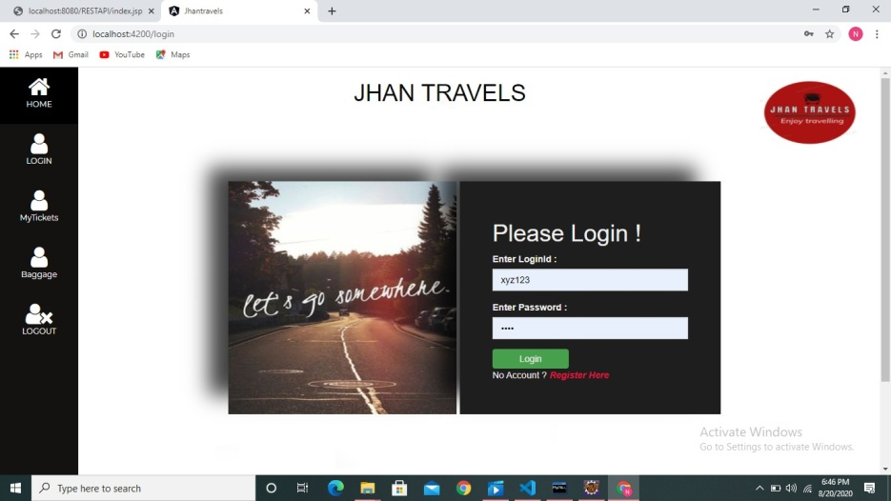
LOGIN PAGE

Slide 11
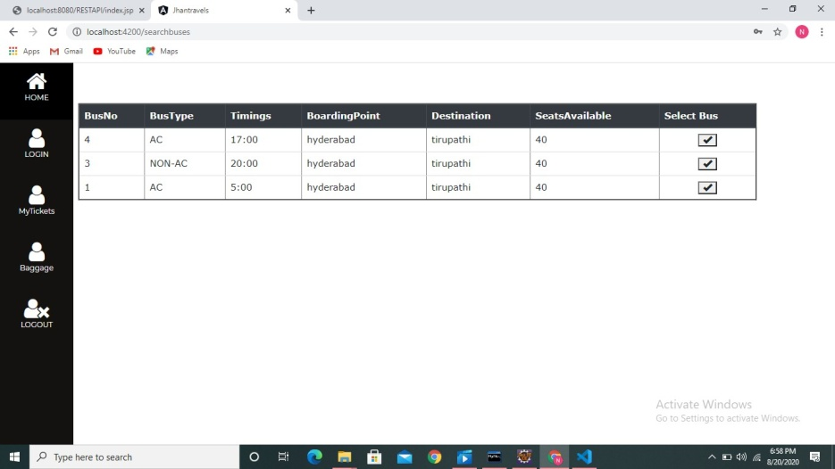
AVAILABLE BUSES BASED ON USER’S CHOICE

Slide 12
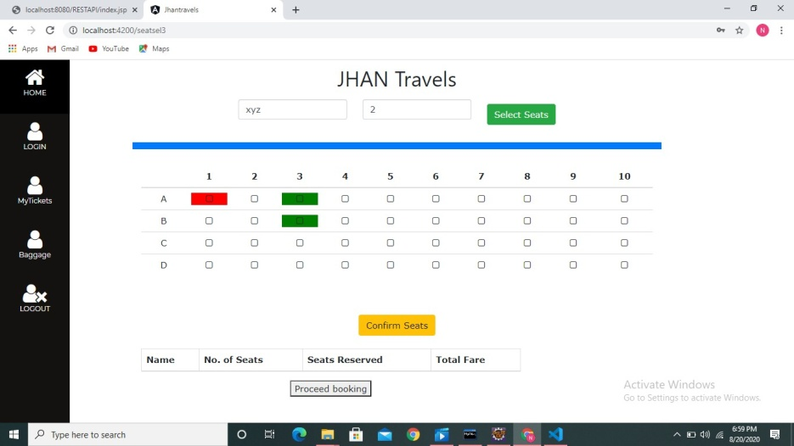
SEAT LAYOUT OF BUS

Slide 13
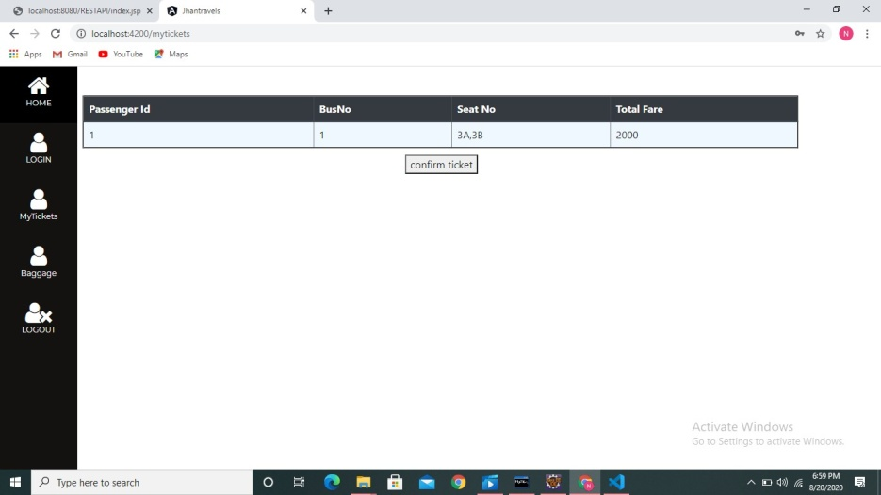
CONFIRMATION OF TICKET

Slide 14
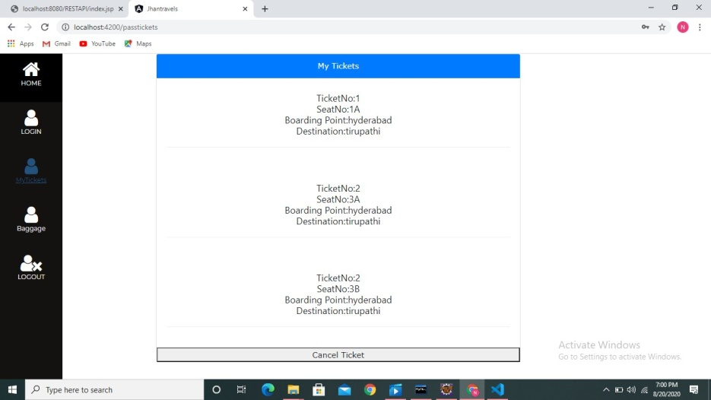
USER’S CONFIRMED TICKETS

Slide 15
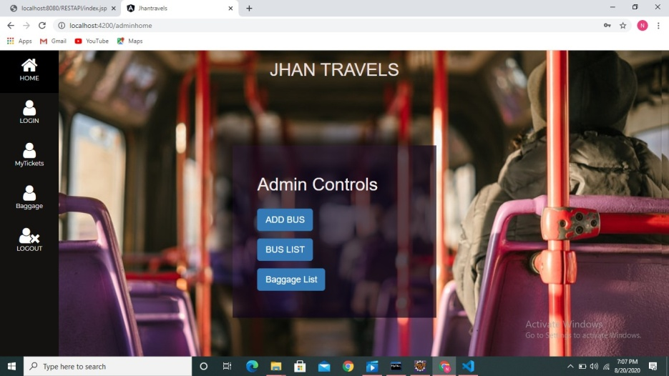
ADMIN HOME PAGE

Slide 16
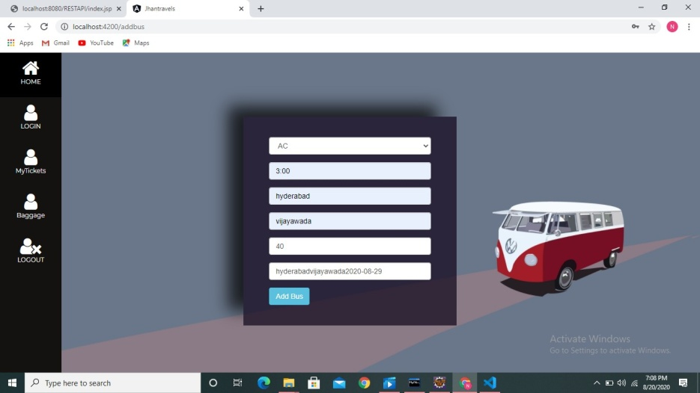
ADDING BUSES BY ADMIN

Slide 17
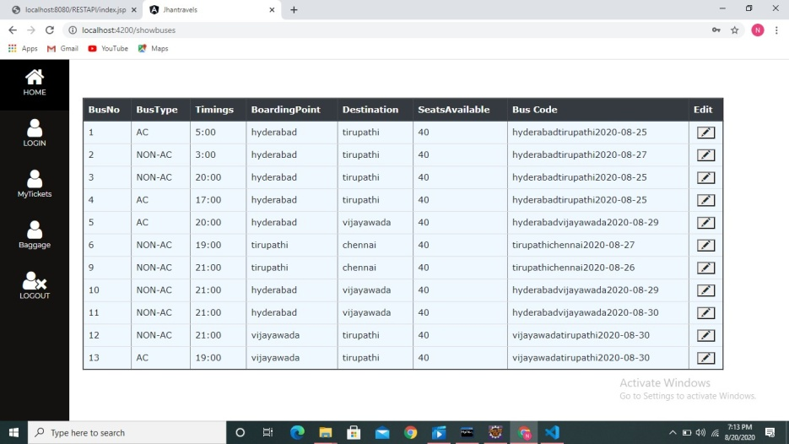
ALL BUSES LIST

Slide 18
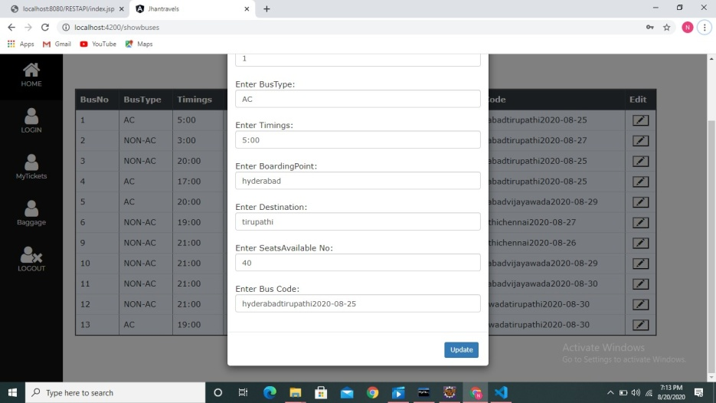
UPDATING BUS DETAILS

Slide 19
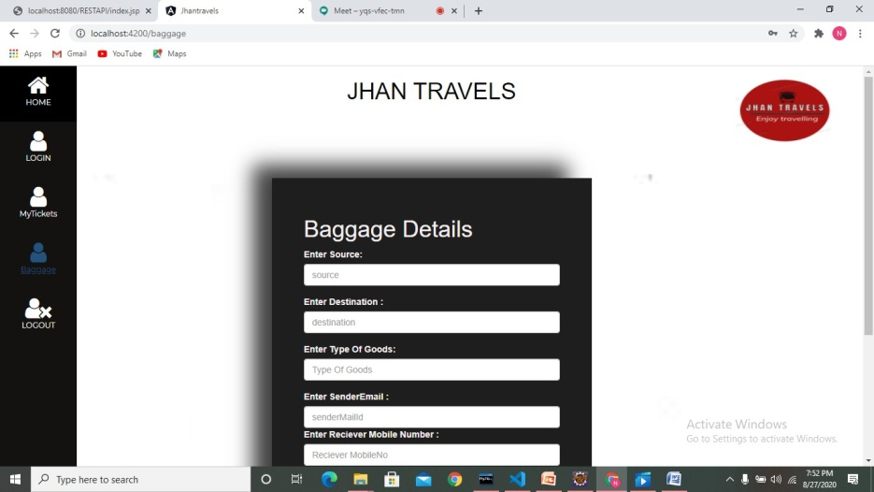
BAGGAGE FORM

Slide 20
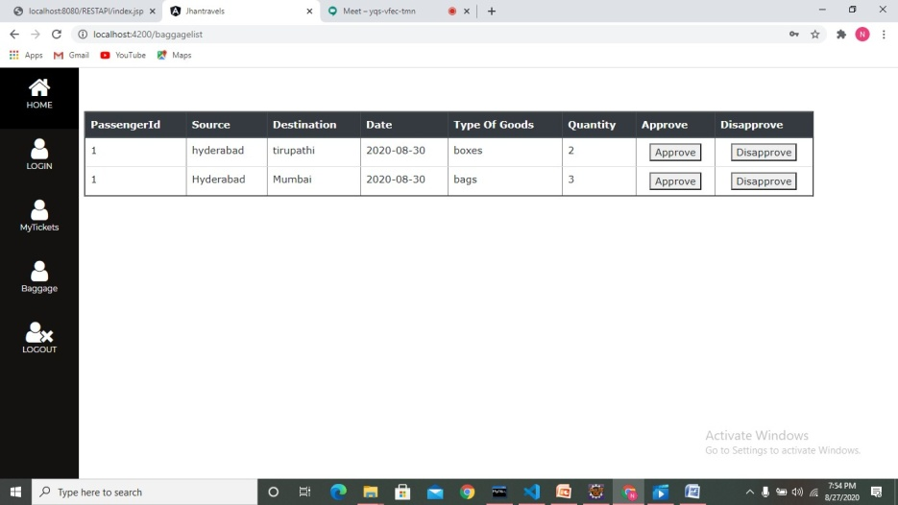
BAGGAGE LIST

Slide 21
CHALLANGES FACED
Displaying the Buses availability according to the source,destination and date of journey given by user.
Showcasing the seat availability. Cancellation of Ticket.

Slide 22
THANK YOU

